Slide 1
Sequence of Host reaction following implantation of biomaterials
Injury
Blood material interaction
Provisional matrix formation
Acute inflammation
Chronic inflammation
Granulation Tissue
Foreign body reaction
Fibrosis/fibrous capsule development

Slide 2
Cells and components of vascularized connective tissue
Intravascular blood cells
Erythryocytes (RBC)
Neutrophils
Monocytes
Eosinophils
Lymphocytes
Basophils
Platelets
Connective tissue cells
Mast cells
Fibroblasts
Macrophages
Lymphocytes
Extracellular matrix components
Collagen
Elastin
Proteoglycan
Fibronectin
Laminin

Slide 3
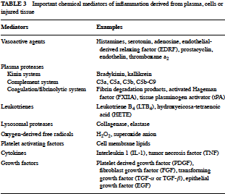

Slide 4
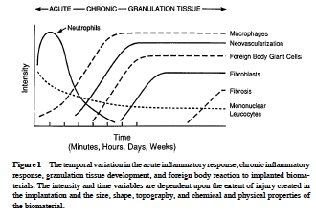

Slide 5
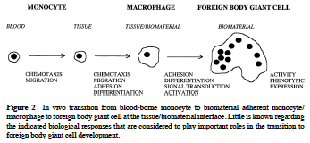

Slide 6
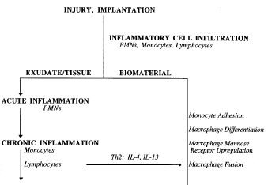


Slide 7
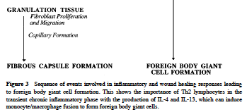

Slide 8
Biomaterials and components relevant to in vivo assessment of tissue compatibility.
The materials of manufacture
Intended additives, process contaminants and residues
Leachable substances
Degradation products
Other components and their interactions in the final product
The properties and characteristics of the final product

Slide 9
Medical device categorization by tissue contact and duration
Surface device
External communicating devices
Implant devices
Contact duration
Skin
Mucosal membranes
Blood path, indirect tissue/bone/dentin communicating
Circulating blood
Tissue/bone
Blood
Limited ≤24h
Prolonged >24h and <30 days
Permanent >30 days

Slide 10
In vivo tests for tissue compatibility
Sensitization
Irritation
Intracutaneous reactivity
Systemic toxicity
Sub chronic toxicity
Genotoxicity
Implantation
Hemocompatibility
Chronic toxicity
Carcinogenicity
Reproductive and developmental toxicity
Biodegradation
Immune response

Slide 11
Potential immunological effects and responses
Effects
Hypersensitivity
Type I anaphylactic
Type II cytotoxic
Type III immune complex
Type IV cell mediated
Chronic inflammation
Immunosuppression
Immunostimulation
Autoimmunity
Responses
Histopathological changes
Host resistance
Clinical symptoms
Cellular responses
T cells
Natural killer cells
Macrophages
Granulocytes

Slide 12
Animal models for the in vivo assessment of medical devices
Cardiovascular
Heart valves
Vascular grafts
Orthopedio/bone
Bone regeneration
Vertebral implants
Cartilages
Neurological
Peripheral nerve reg.
Electrical stimulation
Opthalmological
Contact lens
Intraocular lens
Sheep
Dog, Pigs
Rabbits, dog, pigs, mouse, rats
Sheep, goats, baboon
Rabbit dog
Rat, cat, monkey
Rat, cat, monkey
Rabbit
Rabbit, monkey

